Slide 1


Workforce Development Connections to
Community Development
Frances Smith-Dean, Executive Director
The Zan Wesley Holmes, Jr. Community Outreach Center
Dallas, Texas
2022 Texas Community Development Conference
Monday, March 28th, 2022

Slide 2
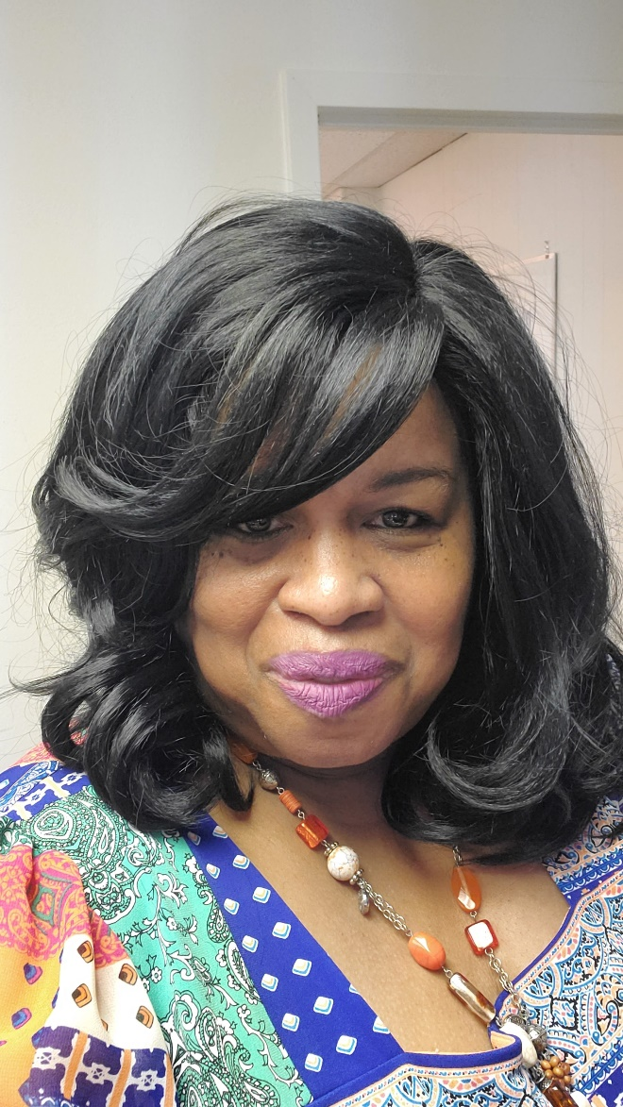
Presenter – Frances Smith-Dean
Executive Director of The Zan Wesley Holmes, Jr. Community Outreach Center
Former Registered Investment Advisor of Retired Plan Advisors of Chicago, ILL.
Adjunct Professor of Mathematics for Dallas College Richland Campus

Slide 3
Agenda
Mission
History
Preparing for the 4th Industrial Revolution
Focusing on Workforce Solutions for the Low Income Individuals
Partnership Opportunities

Slide 4
Mission Statement
Creating Self-sustaining pathways out of poverty for young people and families living in Dallas, Texas through education, training and job placement.
Three pathways:
1 – Entrepreneurship
2 – STEM Workforce – light electrical – low voltage an our new career paths – fiber optics and Xerox digital career pathways
3 – Asset Building – stocks, bonds, precious metals, real estate and cryptocurrencies.

Slide 5
History
Frazier House is a free social service wrap around model with a focus on “economic stability”. The Frazier Model provides services to everyone living within the Dallas Independent School District.
The Zan Wesley Holmes, Jr. Community Outreach Center along with our partners and collaborators have serviced over 8000 individuals from 2019 until now. Partnerships include: Amazon, Fed Ex, Jackson Hewitt, DISD, Smokey John’s Barbeque and St. Luke “Community” United Methodist Church.

Slide 6
Step 1: Accessing the problem…
Texas Cities that rank in the top 20 with the worst connectivity
Which Texas cities with a population of 1000,000 + households have the worst connectivity?
Ranked # 5 Dallas, Texas
Ranked # 14 Houston, Texas
Ranked # 15 San Antonio, Texas

Slide 7
Step 2: Preparing low income communities for the 4th Industrial Revolution –
World Economic Forum states…
The Fourth Industrial Revolution represents a fundamental change in the way we live, work and relate to one another. It is a new chapter in human development, enabled by extraordinary technology advances commensurate with those of the first, second and third industrial revolutions.
These advances are merging the physical, digital and biological worlds in ways that create both huge promise and potential peril. The speed, breadth and depth of this revolution is forcing us to rethink how countries develop, how organizations create value and even what it means to be human.

Slide 8
Getting low-income communities on the right side of this equation – According to the Dallas Federal Reserve Roy, Lopez Assistant Vice President of Community Development
“Who’s on the wrong side of the digital divide? Low-income people, rural populations, those with less formal education, the elderly and minorities”
“For households with a broadband subscription across multiple devices (desktop or laptop and smartphone or tablet), incomes above $150,000 per year have a rate of 80 percent and households with incomes under $25,000 per year, the rate is 20 percent (U.S. Census, ACS, 2016).”

Slide 9
Step 3: Due diligence
Industries that will get disrupted by AI
1. Healthcare
2. Customer Service and Experience
3. Banking, Financial Services, and Insurance (BFSI)
4. Logistics
5. Retail
6. Cybersecurity
7. Transportation
8. Marketing
9. Defense
10. Lifestyle
Source https://www.toolbox.com/tech/artificial-intelligence/tech-101/10-industries-ai-will-disrupt-the-most-by-2030/#_005

Slide 10
Safe Occupations according to World Economic Forum
1 Recreational Therapists
2 First-Line Supervisors of Mechanics, Installers, and Repairers
3 Emergency Management Directors
4 Mental Health and Substance Abuse Social Workers
5 Audiologists
6 Occupational Therapists
7 Orthoptists and Prosthetics
8 Healthcare Social Workers
source http://www3.weforum.org/docs/WEF_Future_of_Jobs.pdf

Slide 11
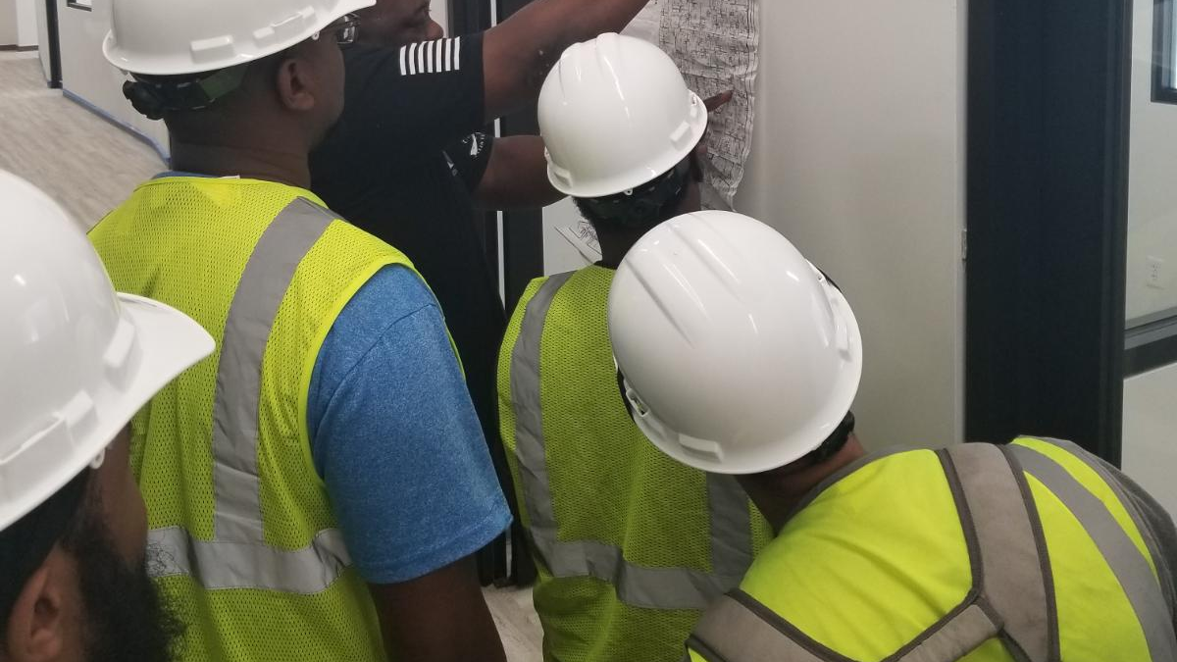
Step 4: Focus on the Opportunities
.
First-Line Supervisors of Mechanics, Installers, and Repairers
Why? Because this provides opportunity for the low-income worker to receive on the job training, build their income, assets and education without having to pay the cost of a 2-yr or 4-yr institution.
Low income individuals need -
- financial support
- social services
- fee and fine reductions

Slide 12
States with the highest employment level in First-Line Supervisors of Mechanics, Installers, and Repairers: according to the Bureau of Labor Statics
State | Employment (1) | Employment per thousand jobs | Location quotient (9) | Hourly mean wage | Annual mean wage (2)
Texas | 44,030 | 3.64 | 1.07 | $ 33.84 | $ 70,390
California | 40,820 | 2.48 | 0.73 | $ 40.73 | $ 84,720
Florida | 29,820 | 3.53 | 1.03 | $ 30.82 | $ 64,100
New York | 26,550 | 3.05 | 0.89 | $ 38.67 | $ 80,440
Pennsylvania | 19,490 | 3.54 | 1.04 | $ 35.62 | $ 74,090

Slide 13
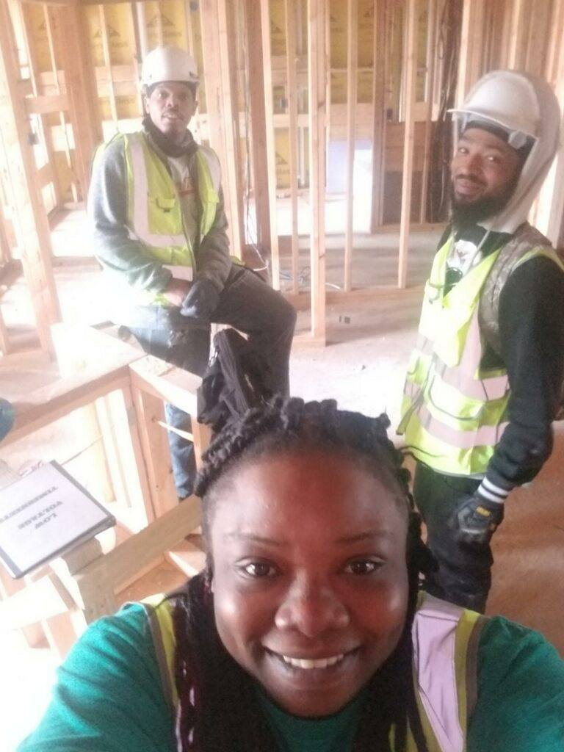
Zan Wesley Holmes, Jr. Community Outreach Center’s Focus
Low Voltage/Fiber Optics Installer
- 8 week on-the-job training
- Students are paid weekly stipends
- Students participate in case management
- Financial literacy and therapeutic wellness
- Installer test preparation
- 35 students have graduated, 7 became entrepreneurs. Wages ranged from 15/hr. to 25/hr.
Job placements: AT&T, City of Dallas, Garland ISD, DISD, Freese & Nichols, Inc. and Infrastructural Wireless.

Slide 14
Low Voltage 4-week Statistics YTD
Participant Completion - 35
 |  | Females | Males | Percentage
Gender |  | 5 | 30
Formerly Incarcerated |  | 2 | 18 | 57%
Some College |  | 1 | 9 | 29%
Negative Net Worth |  | 4 | 22 | 74%
Program Completion
Build Assets |  | 3 | 29 | 91% Stocks, Precious Metals, Real Estate and Crypto
Increased Credit Scores |  | 4 | 29 | 94% | Increased by 20 points or more
Reduced Fines and Fees |  | 3 | 19 | 65%

Slide 15
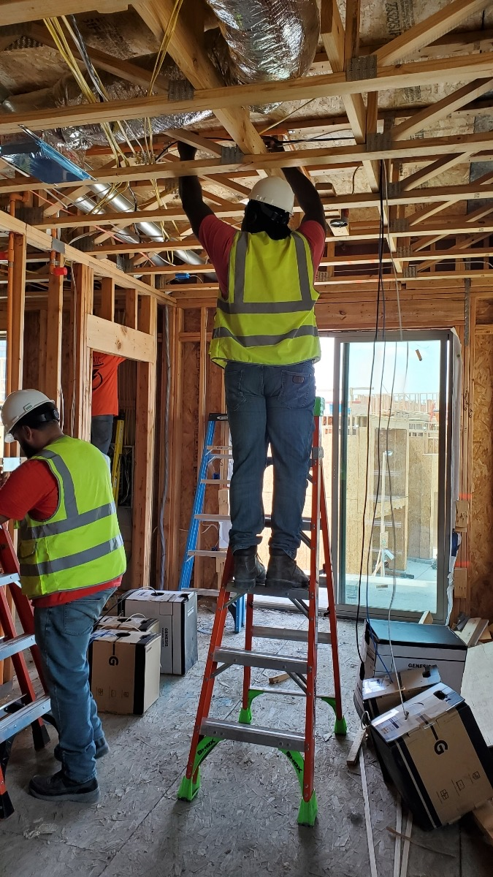
Installer Low Voltage Fiber Optic Program
8 – week program on the job training program
- students receive weekly stipends
- case management, therapeutic wellness and financial literacy.
- students take national certification test
Fiber Optics Installer I and II
Average wage $35 per hour to $125.

Slide 16
Low Voltage & Fiber Optic Cost per Cohort
8-week session – 10 students

Slide 17





Past and Present Funders
Vincent Ratcliff
Treasurer of ZWHJCOC

Slide 18
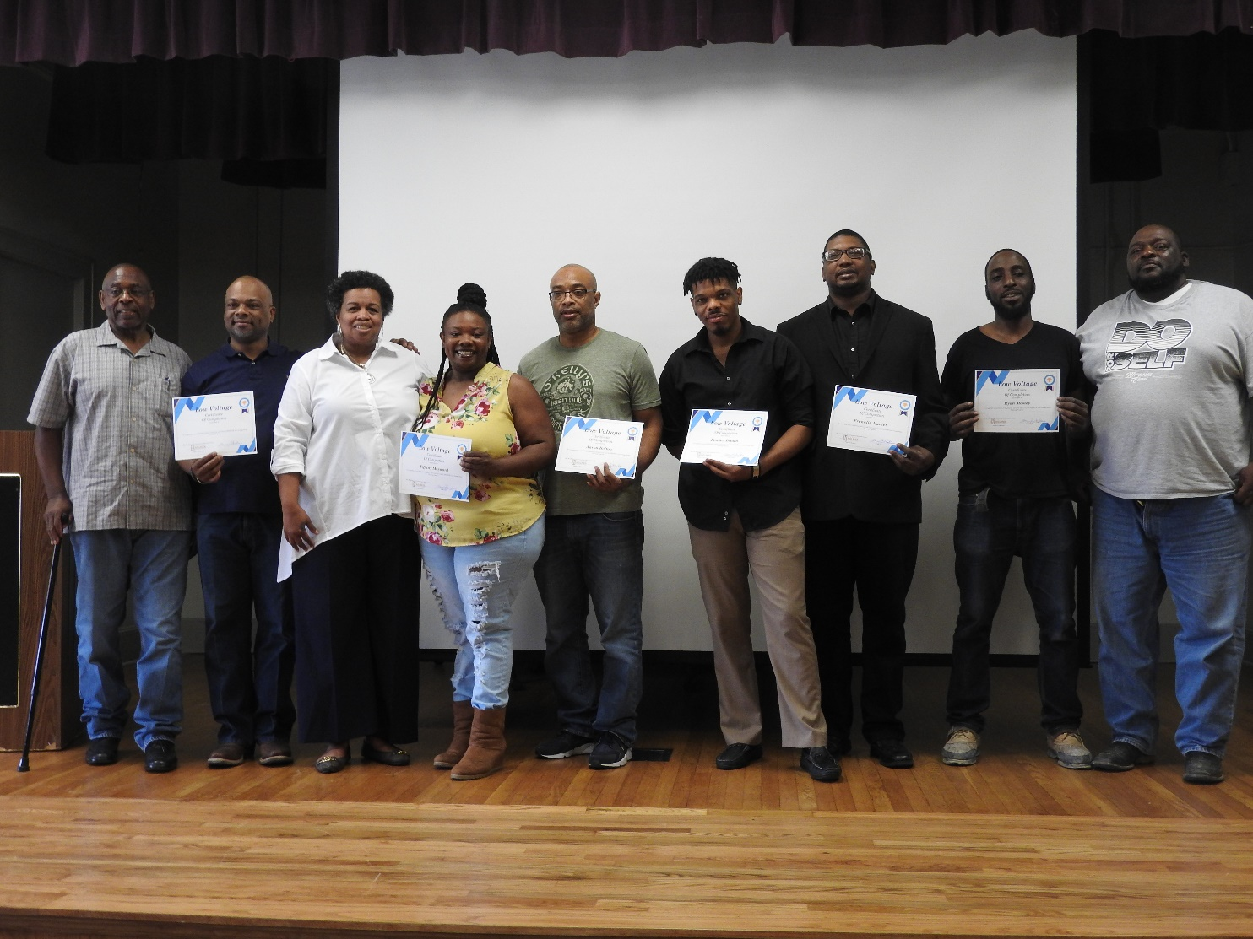
Contact Information
Frances Smith-Dean – Executive Director
Email – frances.smith@zwhjcoc.org
Phone – 214-324-4443
Website – www.zwhjcoc.org
Social Media Pages
Youtube – zwhjcoc
Facebook – Zan Wesley Holmes, Jr Community Outreach Center

