Slide 1
Predatory Lending: Post-Session Update
Brett M. Merfish
512.473.2800 ext 111
bmerfish@texasappleseed.net

Slide 2
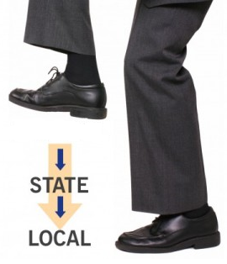
Legislative Session 2017
Successfully defeated preemption
Bills specifically targeting the ordinances (HB 3081, SB 1530)
REINS Bills (HB 3947, SB 2178)
Sneaky seed bill (SB 1172)
Special Session
Broad licensing and permitting bills
Notes:
HB 3081—killed in Calendars (broad effort from large coalition); SB 1530—broad coalition put consistent pressure on committee members (did not have the votes so left pending in committee)
REINS--Relating to judicial review of certain regulations that apply to state licensees; extremely broad (“adverse business impact”), ALEC initiated bill
Seed bill—amended with broad preemption language; broad coalition effort to revise it (not immediately apparent that would affect payday lending and other regulation)
Special Session—licensing and permitting bills aimed at accelerating permitting process and preempting worker protections; written broadly

Slide 3
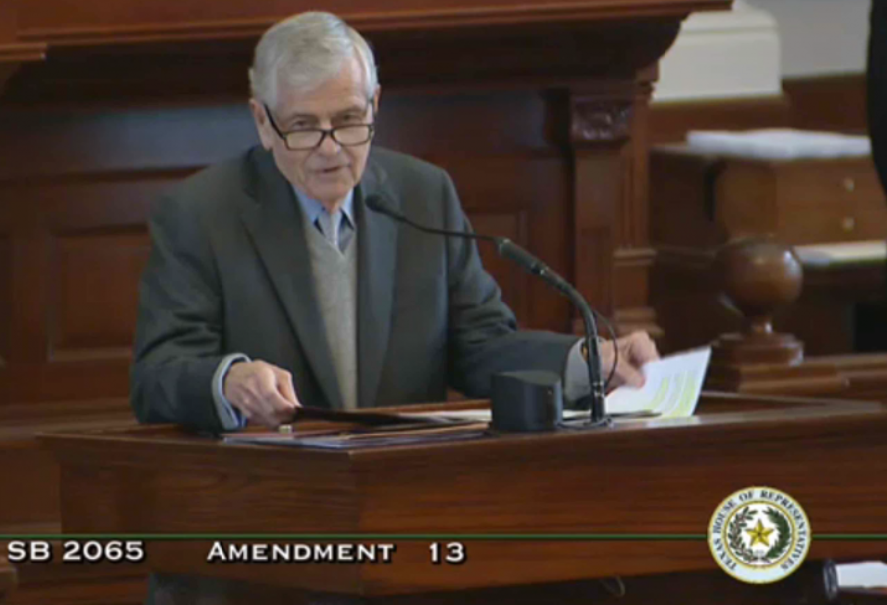
Record Vote on Payday Lending Reform
Record vote on the issue (SB 2065) (one of few)
Capriglione Amendment to Craddick Amendment
After vote, Craddick withdrew Amendment
Notes:
2065 was a licensing bill (vehicle booting, cosmetology, etc.)
Texas Department of Licensing and Regulation
Rumored that payday lenders were adding an amendment preempting city laws
Craddick prepared additional amendment and then decided to offer even after heard that there was no broad preemption amendment.
Capriglione was able to successfully amend the Craddick amendment with preemption, in a close vote, and then Craddick withdrew his amendment.
Close given no lobbying on this specifically

Slide 4
Take-aways
Constant Vigilance
Broad Possibilities for Bills that could cause preemption or be amended
Broad Coalition
Grasstops
Grassroots
Notes:
Also, ancillary products and 342 lenders
Attempts to change 342 loans
Wanted to allow larger loans
No demonstrated need
Attempts to give lenders ability to sell ancillary products
Unnecessary
Lack value

Slide 5
Looking Ahead
Forthcoming Attorney General Opinion
Austin Municipal Court Ruling and Subsequent Litigation
OCCC and Finance Commission Sunset
CFPB Payday and Auto Title Rules (they are finally here!)
Notes:
The law is quite clear, upholding the 180 day limit on the loan, so it will be interesting to see what comes out of the process.

Slide 6
What Will the Rule Cover?
Payday + auto title loans (45 days or less) and installment balloon loans:
Full ability to repay assessment
Limit of two refinances (3 loans in a row, less than 30 days apart).
One exception! No ability to repay required IF
the loan is $500 or less AND
If refinance, each payment reduces principal by 1/3, so paid off after 3 payments.
For all covered loans + consumer installment loans with 36% APR or higher:
must notify borrower before debiting account +
after 2 consecutive failed attempts, new authorization required
Notes:
With certain exceptions, discussed below, the lender is required to make a reasonable determination, for covered loans, as to whether the specific borrower can repay the loan obligation and still meet basic living expenses and other financial obligations during the loan and for thirty days thereafter. The lender generally must verify income and major financial obligations and estimate living expenses.

Slide 7
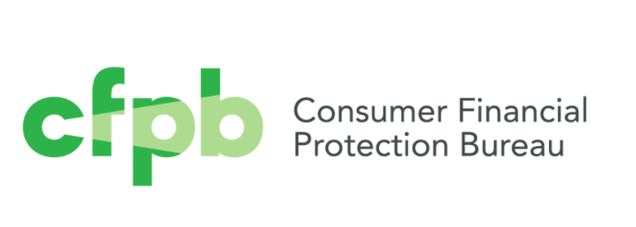
What Does this Mean for Texas?
Federal standard affirming the harm of the debt trap and grounded in ability to repay establishes an important baseline.
73% of Texas transactions covered by rule (2016)
Would have saved $403-432 million in Texas
Flexibility in Texas law for uncapped loans means that payday and auto title lenders could shift to 45-180 day amortizing loans.
Notes:
-savings is a conservative number
-savings does not include parts of online market (tribal lending); does not include limit on failed payment requests; balloon v. installment
-already have 45-180 day amortizing loans (could shift)

Slide 8
The Bottom Line: Rule is an important win, but our work is not over.
Make sure the rule sticks. Congress can overturn it any time in the next 6 months.
https://www.texasappleseed.org/take-action
Stop efforts by payday lenders and others to expand high-cost lending in Texas. For example, ensure lenders are limited to shorter term loans.
Continue the local ordinance movement. Push for more enforcement.
Continue push better alternatives and rate caps.

Slide 9
Brett Merfish: bmerfish@texasappleseed.net
www.texasappleseed.net

