Slide 1

TACDC
Policy AGENDA report
November 9, 2022

Slide 2

Every Texan’s Campaign to Save Texans from the Legislature
by Luis Figueroa
11/9/22

Slide 3
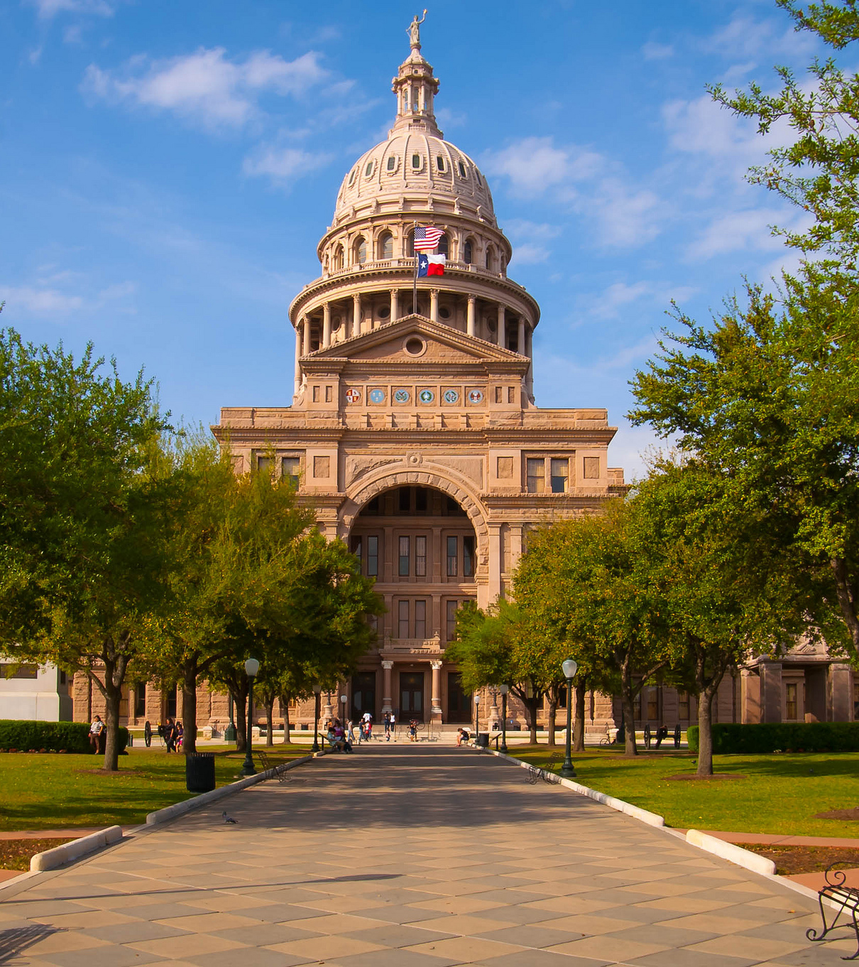
88th Legislature
The 87th served as a “stress test” for democratic participation in Texas.
The 88th will be the rebound year. Some parts will look the same as the pre-pandemic but not everything.
Notes:
The 87th legislative session was a stress test for democratic participation in Texas
Broader context – Public participation must return. Will Dems get to be chairs?
Response - work with partners, digital strategies (highlight SoapBoxx)

Slide 4
6 Policy Agenda Categories
1) Health Care
2) Food Justice
3) Education
4) Worker Power and Supporting Families
5) Fair Taxation
6) Voting Rights
Notes:
Remind Road Map in packets

Slide 5
Policy Priorities: Health Care
Medicaid Expansion
Post Partum Medicaid Coverage
Fund Eligibility Systems and Reduce Barriers As the Public Health Emergency Ends.
OUR Goal: Keep the Pressure On! Find new R’ sponsors to Johnson and Johnson Bill.
OUR Goal: Get the full 12-month coverage per Speaker priority.
OUR Goal: Staff up HHSC and streamline application the process.

Slide 6

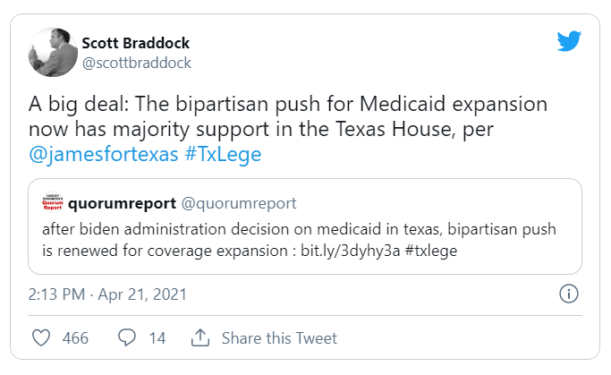
How We Get There? Inside and Outside
Notes:
#SickOfItTX is a multi-year campaign to try and fill the grassroot lane of large, decade-old coverage advocacy effort including dozens of partners and many formal and informal coalitions.
External factors (COVID) and increased investment in organizing, communications, and lobbying capacity helped create pressure this session for lawmakers to do SOMETHING about health coverage (HB 133, HB 290), and over half the House signed on in support of a coverage bill (HB 3871).
Targets for SOIT
Key cmte and leadership members
Moderate Rs
House Dems who mentioned MedEx favorably in campaign
Main outside-game strategies
Media advocacy (multiple media and digital consultants)
Digital campaign (big ad buys in target districts)
created a shell org, Put TX First, for digital campaign to do issue education with conservative voters
Click-to-Call, email and tweet actions hosted by different orgs (including us)
Paid phone programs run by Every Texan
Virtual events
Virtual constituent meetings with targets
Stats (for actions we hosted, not full campaign)
1,259 calls
3,850 emails
Partnership Strategy
Campaign + Coalitions + Funders + Provider groups + hired guns + consultants

Slide 7
Policy Priorities: Food Justice
Update the vehicle asset test for SNAP
Extend SNAP enrollment for families with 12 months of continuous coverage
OUR Goal: Capitalize on inflation concerns and pass a bi-partisan bill
OUR Goal: Capitalize on health care wins and apply same logic to SNAP. Reduce the red tape!

Slide 8

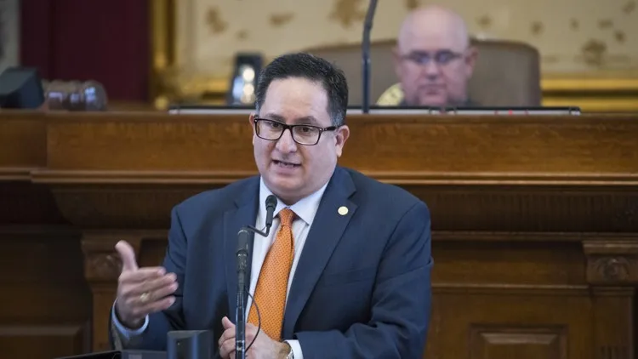
How We Get There? Inside and Outside
Inflation is not just a number it’s about the people
Plus: Some hired help
Notes:
Partnership Strategy
Campaign + Coalitions + hired guns- Feeding Texas funded

Slide 9
Policy Priorities: Investing in Public Schools & Higher ED
Use average daily enrollment to calculate school funding instead of average daily attendance or just increase the Basic Allotment
Expand culturally relevant and academically sound programing.
Reduce college debt for low-income families.
  OUR Goal: Grow momentum with members and gain a broader base of support
  OUR GOAL: New area for Every TXN- start changing the conversation with innovation
  OUR GOAL: Invest in TEOG and protect in-state tuition for undocumented students

Slide 10
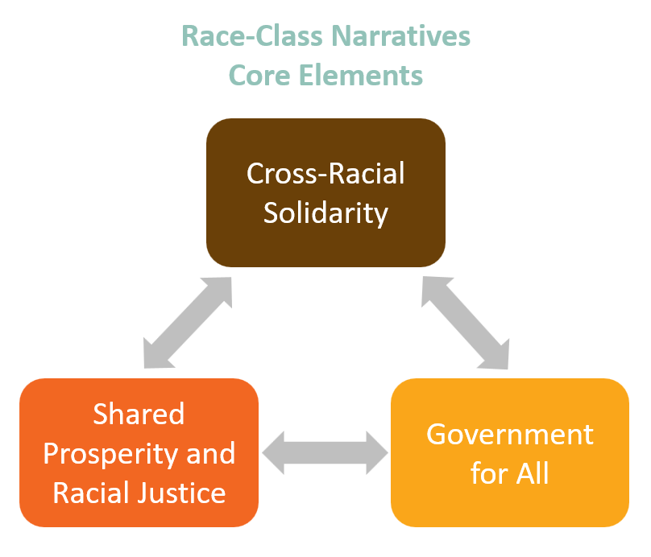

How We Get There? Educating members, building coalitions and a movement -People’s Budget
Long-term Investments in Education
Race-Class Narrative Key Component
Notes:
Partnership Strategy- adopted RCN in strategic plan

Slide 11
Policy Priorities: Worker Power and Supporting Families
Fight abusive state interference, especially on worker rights
Support Kinship families
Immigration
OUR Goal: Make it not worth the fight
OUR Goal: Build broader support for kinship families
OUR Goal: Need to start reducing the costs of Operation Lonestar

Slide 12


How Do We Get there? Community Engagement: Bring the People Back
Story Telling
PEOPLE’S BUDGET
Notes:
Bringing people back is crucial to our success on pre-emption.
Story telling is critical for kinship issues →Soapboxx is an online platform that allows users to record video testimony for causes they care about. This is a quick and easy way for Texans to share their stories and have their voices amplified across social media platforms.
----
Although we did not get a legislative hearing, Every Texan along with our RITA coalition partners hosted a hybrid advocacy day to raise awareness on expanding access to drivers license permits. On May 25th, we hosted an advocacy day Drive Texas Adelante. Throughout the course of the day, we held an in-person rally in the main rotunda, a press conference where legislators spoke, and a people’s hearing where Texans from across the state shared their testimony on why conditional driver’s permits are important to them, their families, and their communities. In addition to the in-person events, Every Texan received nearly 60 recorded testimonies via Soapboxx in support of conditional driver’s permits. These testimonies along with the live events were broadcasted on Facebook Live and reached hundreds of Texans. We’re hopeful that the momentum created this legislative session will set us up for the 88th session. - Katie

Slide 13
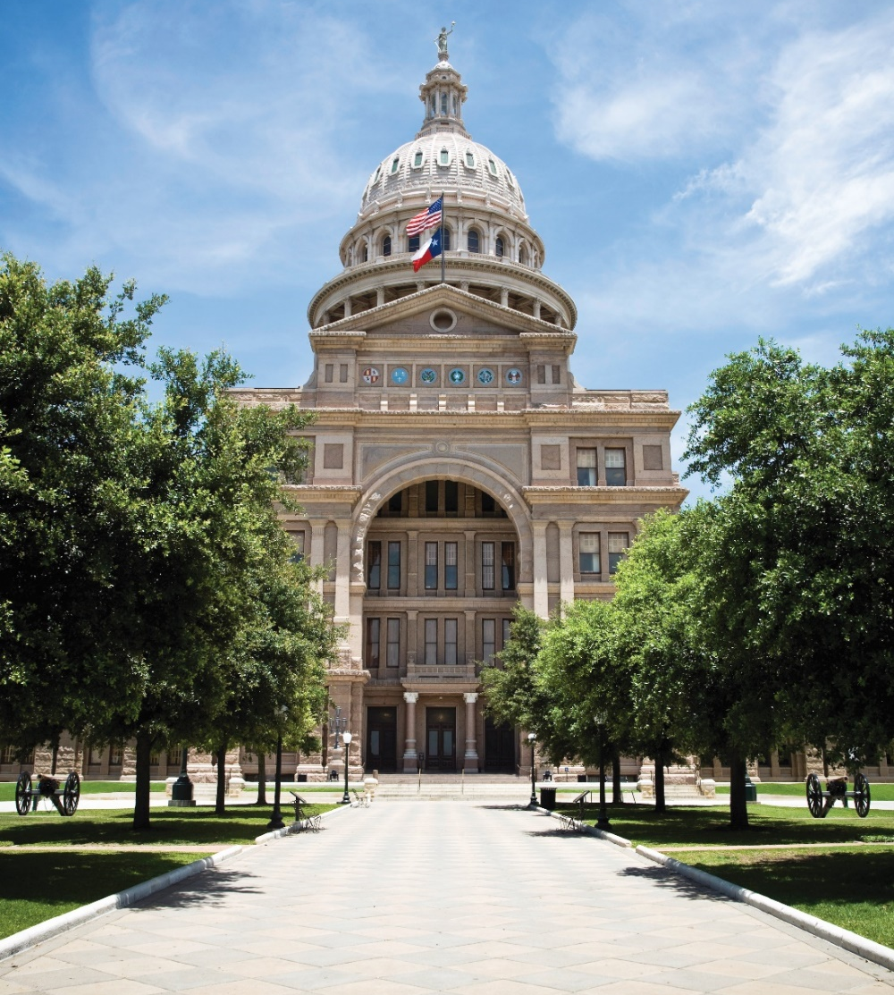
Policy Priorities: Fair Taxation
Do not reauthorize the massive school property tax giveaway program (Chapter 313) that gives corporations unnecessary tax breaks.
Use the Economic Stabilization Fund (Rainy Day Fund) as it was intended
  OUR Goal: CH. 313 fails to reauthorize again!
  OUR Goal: Tax cuts are equitable and balanced with education and health care spending

Slide 14
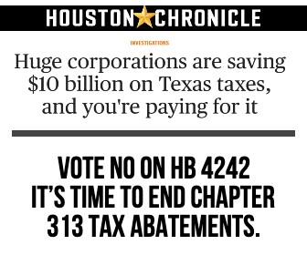
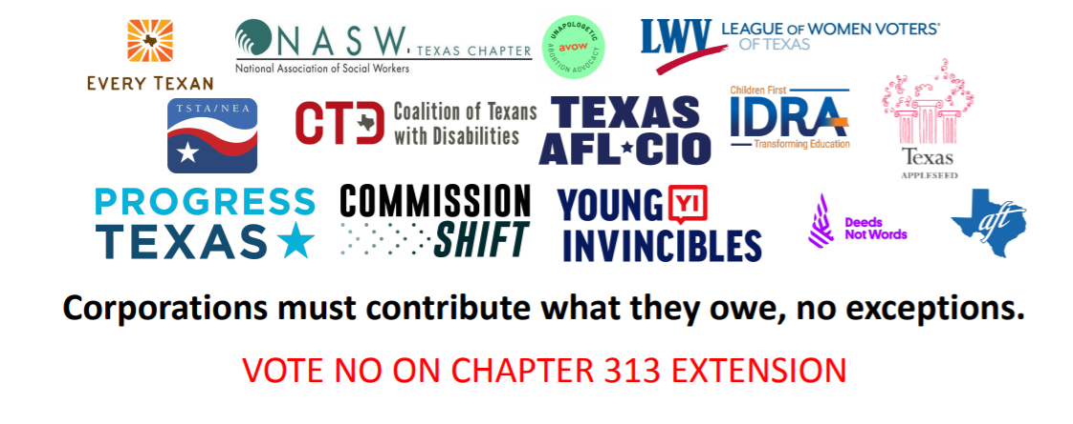
How Do We Get There? Rinse and Repeat!
Notes:
Inside game: Influence length and terms of Ch 313 renewal
Outside game: End Ch 313 school property tax abatement program
Targets
More progressive Dems, worked our way toward the center from the left (TPPF etc did the same from the right)
Main outside-game strategies
In-house click-to-call and click-to-email actions
In-house text and email alerts
Digital (social media) and mobile (device targeting) ads
Patch-through phone programs
Media advocacy
Framing
As Texans, we know that when it comes to contributing, everyone means everyone, no exceptions.
Texans support education funding. Previous messaging research (Prop 4) reinforced that progressive Texans support wealthy households and corporations paying more in state and local taxes.
Texans are tired of our government putting corporate profits over the well-being of people.
Race-forward and class-inclusive messaging framework with help from We Make the Future that leans into our new social justice branding allowed us to focus on the fact that corporations should pay taxes as the central theme of messaging (vs trying to explain what CH 313 is or debate merits as an econ dev program)
Pointing out that corporations are shirking contributions that the rest of us make helped erode Dem support for Ch 313.
Previous messaging research reinforced that progressive Texans support wealthy households and corporations paying more in state and local taxes.
Partnership Strategy
“Network approach” leveraging partners across issue areas, former Texas Forward members, labor, and new progressive allies
Interfaith groups
TPPF/conservative lobbyists (inside game)

Slide 15

Policy Priorities: Voting Rights
Support measures that increase voter participation
  OUR Goal: Start to repair the damage done by SB 1
Notes:
Inside game: Influence length and terms of Ch 313 renewal
Outside game: End Ch 313 school property tax abatement program
Targets
More progressive Dems, worked our way toward the center from the left (TPPF etc did the same from the right)
Main outside-game strategies
In-house click-to-call and click-to-email actions
In-house text and email alerts
Digital (social media) and mobile (device targeting) ads
Patch-through phone programs
Media advocacy
Framing
As Texans, we know that when it comes to contributing, everyone means everyone, no exceptions.
Texans support education funding. Previous messaging research (Prop 4) reinforced that progressive Texans support wealthy households and corporations paying more in state and local taxes.
Texans are tired of our government putting corporate profits over the well-being of people.
Race-forward and class-inclusive messaging framework with help from We Make the Future that leans into our new social justice branding allowed us to focus on the fact that corporations should pay taxes as the central theme of messaging (vs trying to explain what CH 313 is or debate merits as an econ dev program)
Pointing out that corporations are shirking contributions that the rest of us make helped erode Dem support for Ch 313.
Previous messaging research reinforced that progressive Texans support wealthy households and corporations paying more in state and local taxes.
Partnership Strategy
“Network approach” leveraging partners across issue areas, former Texas Forward members, labor, and new progressive allies
Interfaith groups
TPPF/conservative lobbyists (inside game)

Slide 16


How Do We Get There? Voter outrage in key districts and independent allies

Slide 17
Pillars for Success
Inside Game (Staff briefings (4 scheduled), Caucus engagement, direct visits and email, networking)
2) Research and Data
3) Outside Game (Campaigns supported by Community and Coalition Engagement)
4) Effective Messaging and Comms Support

Slide 18
Timeline- Upcoming Events
1) Election Day- November 8
2) Bill Filing Begins- November 14
3) First Day of 88th Session- January 10
4) Biennial Revenue Estimate- Early January (Jan. 11)
5) Last Day to File Bills- March 10 (60th day of session)
6) Sine Die- May 29

Slide 19


